Slide 1

DEPARTMENT OF COMPUTER SCIENCE AND ENGINEERING CMR TECHNICAL CAMPUS 2019-2023 A MAJOR PROJECT ON License Plate Image Analysis Empowered by Generative Adversarial Neural Networks (GANs)
Under the Guidance of
A. UDAY KIRAN
(Assistant Professor)
BY–
M. MANAS REDDY (187R1A05L1)
K. SHASHIDER (187R1A05P1)

Slide 2
ABSTRACT
License Plate Image Analysis system is one of the smart transportation methods that provides a safe medium of transportation and monitoring planning used by many two-wheeler vehicles as well as four-wheeler vehicles to boost traffic controlling, routing, parking system, toll collection, and governance and insuring highway law. There are various techniques and algorithms has been developed so that we can identify and recognize Number plates. This paper shows a various deep learning approach for recognizing and detecting number plate. This system is divided into three parts, i.e. number plate detection, segmentation, and character recognition. In our proposed system for number plate detection Yolo method is used, after that some filters are applied and then characters are segmented. Finally, the Convolutional Neural Network is used to recognize all the segmented characters.

Slide 3
EXISTING SYSTEM
Rapid road traffic requires a large amount of traffic monitoring and management skills. In this case, you will not be able to manually track vehicles moving at high speeds on the road. Also, human energy and time is wasted.
It is having been operated manually, that will cause a lot of difficulty and many mistakes. Hence there is a necessary to make an automated system that assist in tracking vehicles by tracking their number plate in a more efficiently.

Slide 4
DISADVANTAGES
Requires more man power
Time consuming

Slide 5
PROPOSED SYSTEM
This paper shows a various deep learning approach for recognizing and detecting number plate. This system is divided into three parts, i.e. number plate detection, segmentation, and character recognition.
In our proposed system for number plate detection Yolo method is used, after that some filters are applied and then characters are segmented.

Slide 6
ADVANTAGES
Recognize all the segmented characters.
No contents can be missed

Slide 7
HARDWARE REQUIRMENTS
Operating system : Windows 10
Processor : Intel i5
Ram : 4 GB
Hard disk : 250 GB

Slide 8
SOFTWARE REQUIRMENTS
Operating System - Windows 7/8
Language - Python 3.7

Slide 9
NOVELTY
The novel proposed a super-resolution model with two separate criteria based on the generative adversarial network architecture. We have designed the method of adding the swish function as an activation function and SRGAN models with content and adversarial loss in the first model (Model I) and adversarial loss with TV-Regularized function in the second model (Model II) are introduced and evaluated.

Slide 10
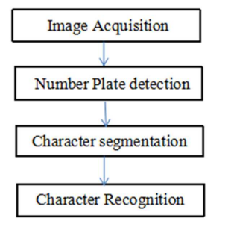
ARCHITECTURE

Slide 11
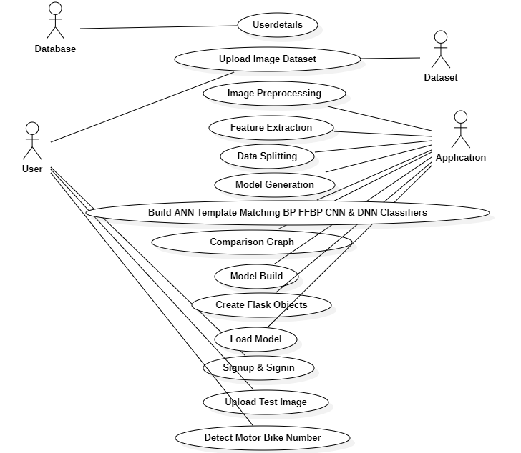
Use case Diagram

Slide 12
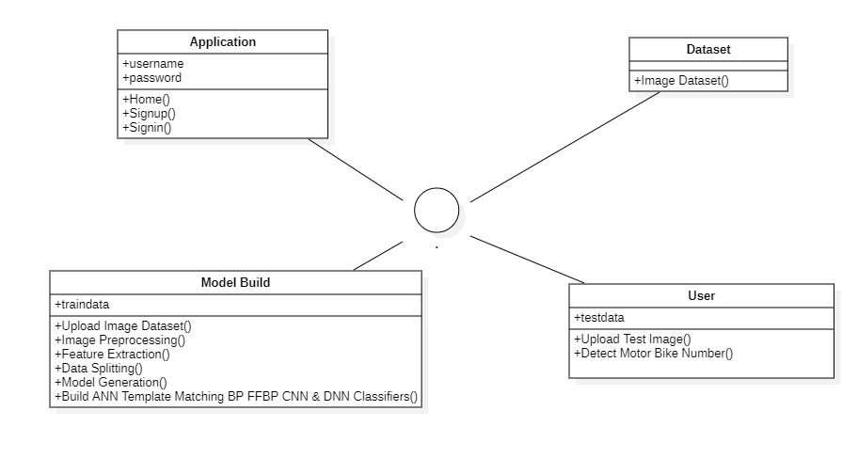
Sequence Diagram

Slide 13
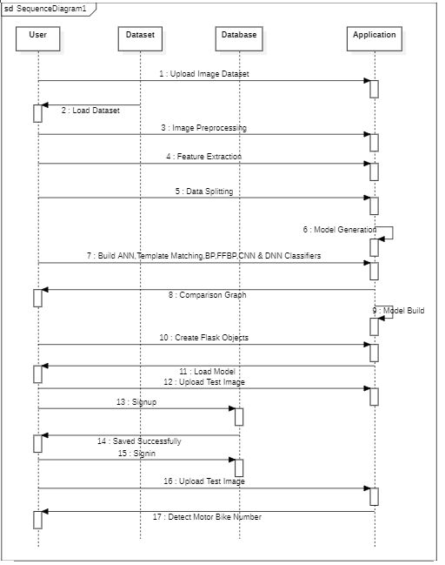
Class Diagram

Slide 14
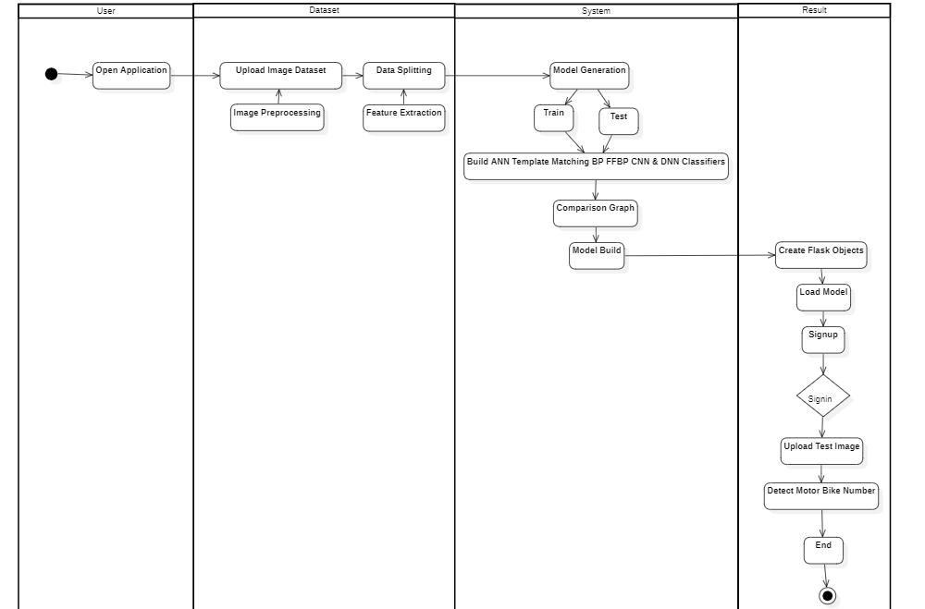
Activity Diagram

Slide 15
SAMPLE CODE
import os
from flask import Flask, render_template, request, send_file
import io
import os
from PIL import Image
import cv2
import numpy as np
from torchvision.models import detection
import torch
from torchvision import models
from flask import Flask, render_template, request, redirect, Response
import sqlite3

Slide 16
from dl_prediction.predictor import Predictor
from flask import Flask, request, jsonify, render_template
import os
from flask_cors import CORS, cross_origin
from com_in_ineuron_ai_utils.utils import decodeImage
from Detector import Detector
from logger import getLog
app = Flask(__name__)
app.config['SEND_FILE_MAX_AGE_DEFAULT'] = 0
CORS(app)
logger=getLog('clientApp.py')
class ClientApp:
def __init__(self):
try:
self.filename = "inputImage.jpg"
self.obj_detect = Detector()
logger.info("ClientApp object initialized")

Slide 17
except Exception as e:
logger.exception(f"Failed to initialize App Object : \n{e}")
raise Exception("Failed to initialize App Object")
predictor = Predictor()
output_car_file = 'static/output_car.jpg'
output_license_file = 'static/output_license.jpg'
output_license_original_file = 'static/output_license_original.jpg'
output_video_file = 'static/output_video.mp4'
@app.route('/')
@app.route('/home')
def home():
return render_template('home.html')
@app.route('/logon’)
def logon():
return render_template('signup.html')
@app.route('/login')

Slide 18
def login():
return render_template('signin.html')
@app.route("/signup")
def signup():
username = request.args.get('user','')
name = request.args.get('name','')
email = request.args.get('email','')
number = request.args.get('mobile','')
password = request.args.get('password','')
con = sqlite3.connect('signup.db')
cur = con.cursor()
cur.execute("insert into `info` (`user`,`email`, `password`,`mobile`,`name`) VALUES (?, ?, ?, ?, ?)",(username,email,password,number,name))
con.commit()
con.close()
return render_template("signin.html")

Slide 19
@app.route("/signin")
def signin():
mail1 = request.args.get('user','')
password1 = request.args.get('password','')
con = sqlite3.connect('signup.db')
cur = con.cursor()
cur.execute("select `user`, `password` from info where `user` = ? AND `password` = ?",(mail1,password1,))
data = cur.fetchone()
if data == None:
return render_template("signin.html")
elif mail1 == 'admin' and password1 == 'admin':
return render_template("index.html")
elif mail1 == str(data[0]) and password1 == str(data[1]):
return render_template("index.html")
else:
return render_template("signup.html")

Slide 20
@app.route('/yolo')
def yolo():
return render_template("yolo.html")
@app.route('/yolo-upload', methods=['POST'])
def yolo_upload():
isImage = request.args.get('type') == 'image'
isVideo = request.args.get('type') == 'video'
file = request.files['file']
file.save(file.filename)
license_txt = predictor.predict(file.filename, output_car_file, output_license_original_file, output_license_file)
os.remove(file.filename)
return render_template("yolo.html")
@app.route('/cnn')
def cnn():
return render_template("cnn.html")
@app.route('/cnn-upload', methods=['POST'])

Slide 21
def cnn_upload():
isImage = request.args.get('type') == 'image'
isVideo = request.args.get('type') == 'video'
file = request.files['file']
file.save(file.filename)
license_txt = predictor.predict(file.filename, output_car_file, output_license_original_file, output_license_file, is_cnn=True)
os.remove(file.filename)
return render_template("cnn.html")
model = torch.hub.load("ultralytics/yolov5", "custom", path = "best.pt", force_reload=True)
model.eval()
model.conf = 0.5
model.iou = 0.45
from io import BytesIO
def gen():
"""

Slide 22
The function takes in a video stream from the webcam, runs it through the model, and returns the output of the model as a video stream ""“
cap=cv2.VideoCapture(0)
while(cap.isOpened()):
success, frame = cap.read()
if success == True:
ret,buffer=cv2.imencode('.jpg',frame)
frame=buffer.tobytes()
img = Image.open(io.BytesIO(frame))
results = model(img, size=640)
results.print()
img = np.squeeze(results.render())
img_BGR = cv2.cvtColor(img, cv2.COLOR_RGB2BGR)
else:
break

Slide 23
frame = cv2.imencode('.jpg', img_BGR)[1].tobytes()
yield(b'--frame\r\n'b'Content-Type: image/jpeg\r\n\r\n' + frame + b'\r\n')
@app.route('/video')
def video():
"""
It returns a response object that contains a generator function that yields a sequence of images
:return: A response object with the gen() function as the body.
"""
return Response(gen(),
mimetype='multipart/x-mixed-replace; boundary=frame')
@app.route("/predict1", methods=["GET", "POST"])
def predict():
"""
The function takes in an image, runs it through the model, and then saves the output image to a static folder

Slide 24
if request.method == "POST":
if "file" not in request.files:
return redirect(request.url)
file = request.files["file"]
if not file:
return
img_bytes = file.read()
img = Image.open(io.BytesIO(img_bytes))
results = model(img, size=640)
results.render()
for img in results.render():
img_base64 = Image.fromarray(img)
img_base64.save("static/image0.jpg", format="JPEG")
return redirect("static/image0.jpg")
return render_template("index.html")

Slide 25
@app.route("/index")
def index():
return render_template("index.html")
@app.route("/about")
def about():
return render_template("about.html")
@app.route("/notebook")
def notebook():
return render_template("Notebook.html")
@app.route("/notebook1")
def notebook1():
return render_template("Notebook1.html")
@app.route("/charyolo")
def charyolo():
return render_template("index1.html")

Slide 26
@app.route("/predict", methods=['POST'])
@cross_origin()
def predictRoute():
try:
image = request.json['image']
logger.info("Image loaded")
clApp = ClientApp()
decodeImage(image, clApp.filename)
result = clApp.obj_detect.run_inference()
return jsonify(result)
except Exception as e:
return jsonify(e)
if __name__ == '__main__':
app.run(debug=False)

Slide 27
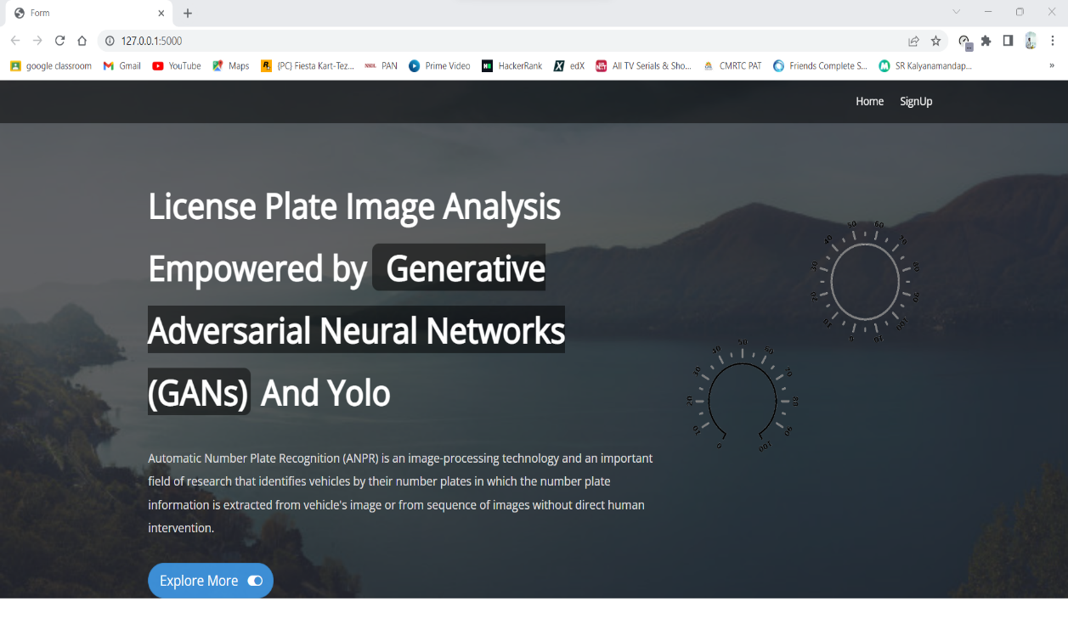
RESULTS
Home page

Slide 28
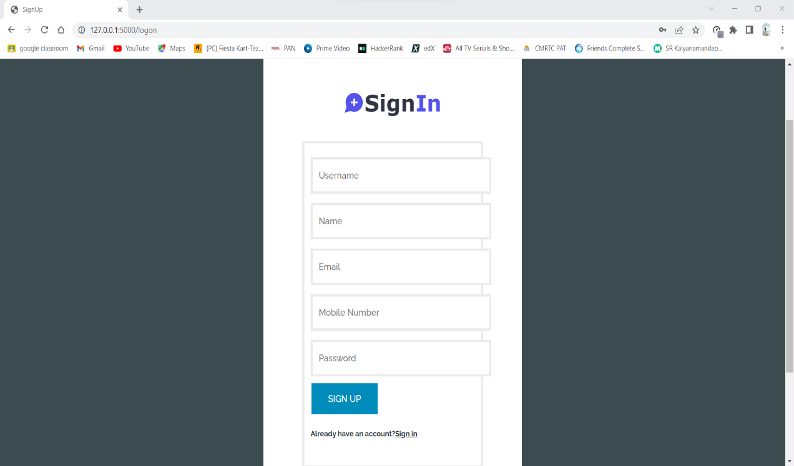
Sign In Page

Slide 29
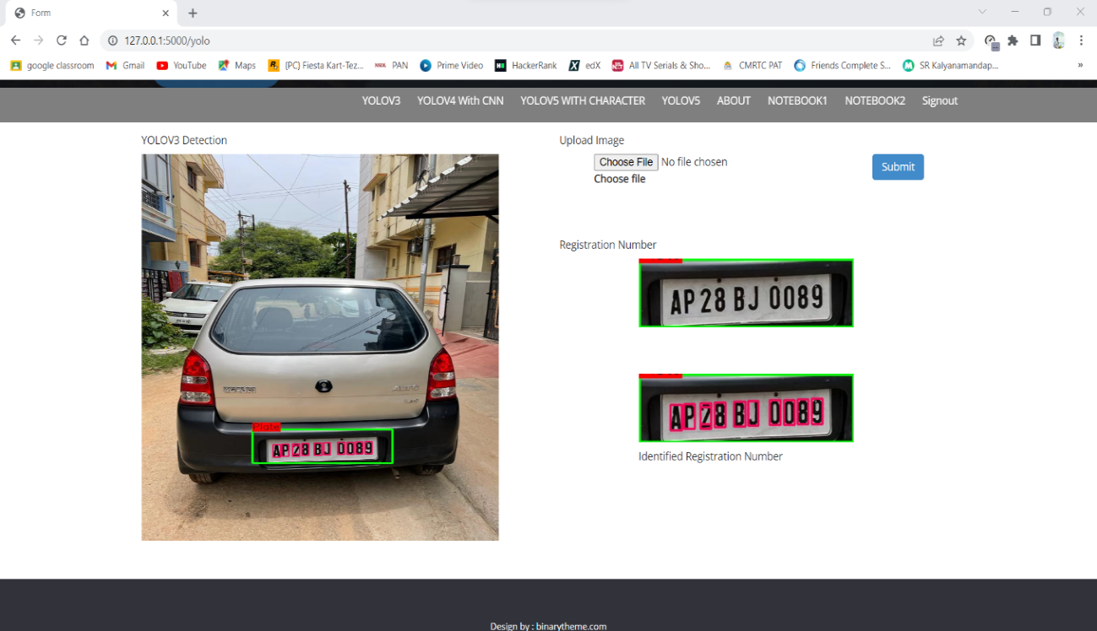
Yolo V3 Detection

Slide 30
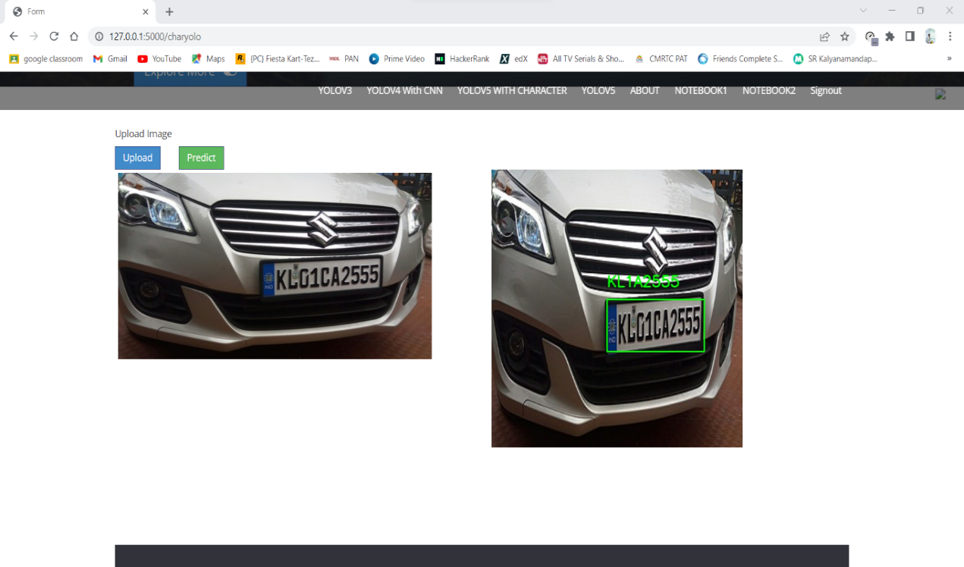
Yolo V5 with Character

Slide 31
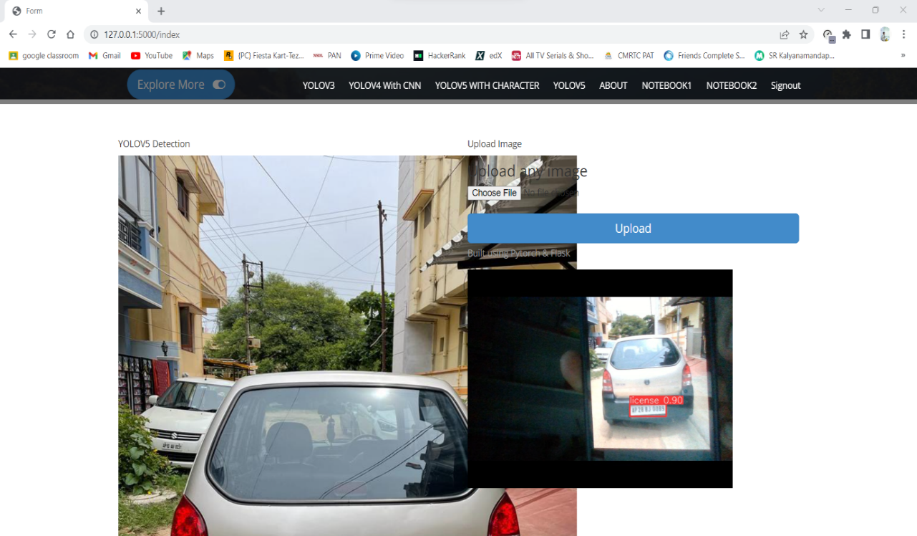
Yolo V5

Slide 32
CONCLUSION
License Plate Image Analysis system is a significant execution of artificial intelligence solutions for numerous aspects. It is generally helpful for security purposes, keeping vehicle record, toll collection, improved traffic monitoring, better parking system, vehicle tracking, etc. Many studies have been conducted on automatic number plate detection as well as character recognition. In reality, a variety of researchers have been done on many methods and techniques for this process. From the survey we can understand that there are different methods and techniques used and it has advantages and disadvantages, and the effectiveness of technique is different from each other. Each country has its own number plate numbering system, different number plate sizes and colors, and character language. The above survey can give you that Valuable understanding and instructions for the approach use. We have proposed a deep learning technique represented by the CNN model for both number plate detection and character recognition for ensuring a decent function of automatic Number Plate Recognition system.

Slide 33
FUTURE ENHANCEMENT
The proposed algorithm gives higher accuracy than the existing algorithms also, it improves the complexity issues throughout the dataset. Also, we have planned to integrate the web server and the application. Also, the things algorithms will be further improved to much higher accuracy.

Slide 34
REFERENCES
Selmi, Zied; Ben Halima, Mohamed; Alimi, Adel M. (2017). [IEEE 2017 14th IAPR International Conference on Document Analysis and Recognition (ICDAR) - Kyoto, Japan (2017.11.9-2017.11.15)] 2017 14th IAPR International Conference on Document Analysis and Recognition (ICDAR) - Deep Learning System for Automatic License Plate Detection and Recognition.
Varma P, Ravi Kiran; Ganta, Srikanth; B, Hari Krishna; Svsrk, Praveen (2020). A Novel Method for Indian Vehicle Registration Number Plate Detection and Recognition using Image Processing Techniques. Procedia Computer Science.
Xie, Lele; Ahmad, Tasweer; Jin, Lianwen; Liu, Yuliang; Zhang, Sheng (2018). A New CNN-Based Method for Multi-Directional Car License Plate Detection. IEEE Transactions on Intelligent Transportation Systems.
Hossen, M. S., Akter, M., & Saifuddin, K. M. (2021). Automatic Digit and Alphabet Recognition Based Online Toll Collection System. 2021 International Conference on Information and Communication Technology for Sustainable Development (ICICT4SD).
Jamtsho, Yonten; Riyamongkol, Panomkhawn; Waranusast, Rattapoom (2019). Real-time Bhutanese license plate localization using YOLO. ICT Express.
Hashmi, S. N., Kumar, K., Khandelwal, S., Lochan, D., & Mittal, S. (2019). Real Time License Plate Recognition from Video Streams using Deep Learning. International Journal of Information Retrieval Research.

Slide 35
GITHUB LINK
https://github.com/Manasreddy506/LicencePlateAnalysis

Slide 36
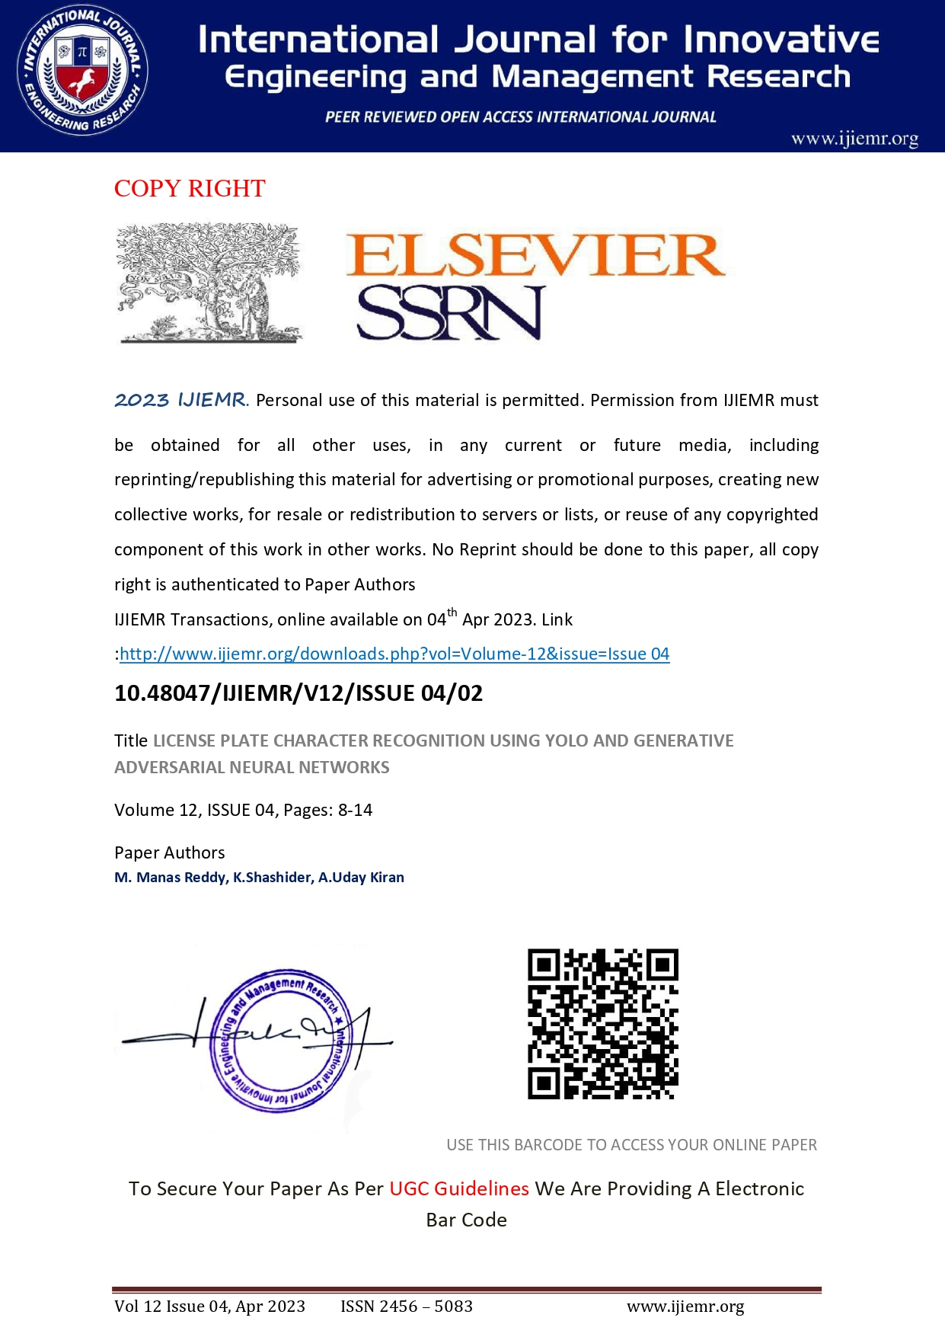
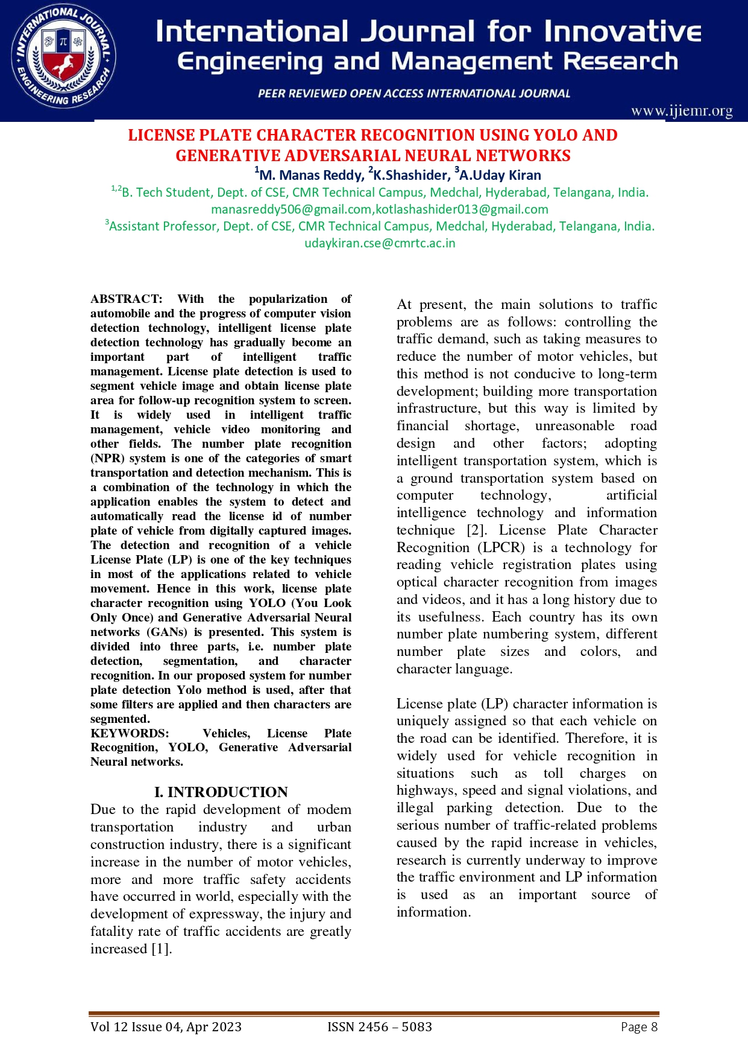
PAPER PUBLICATIONS

Slide 37
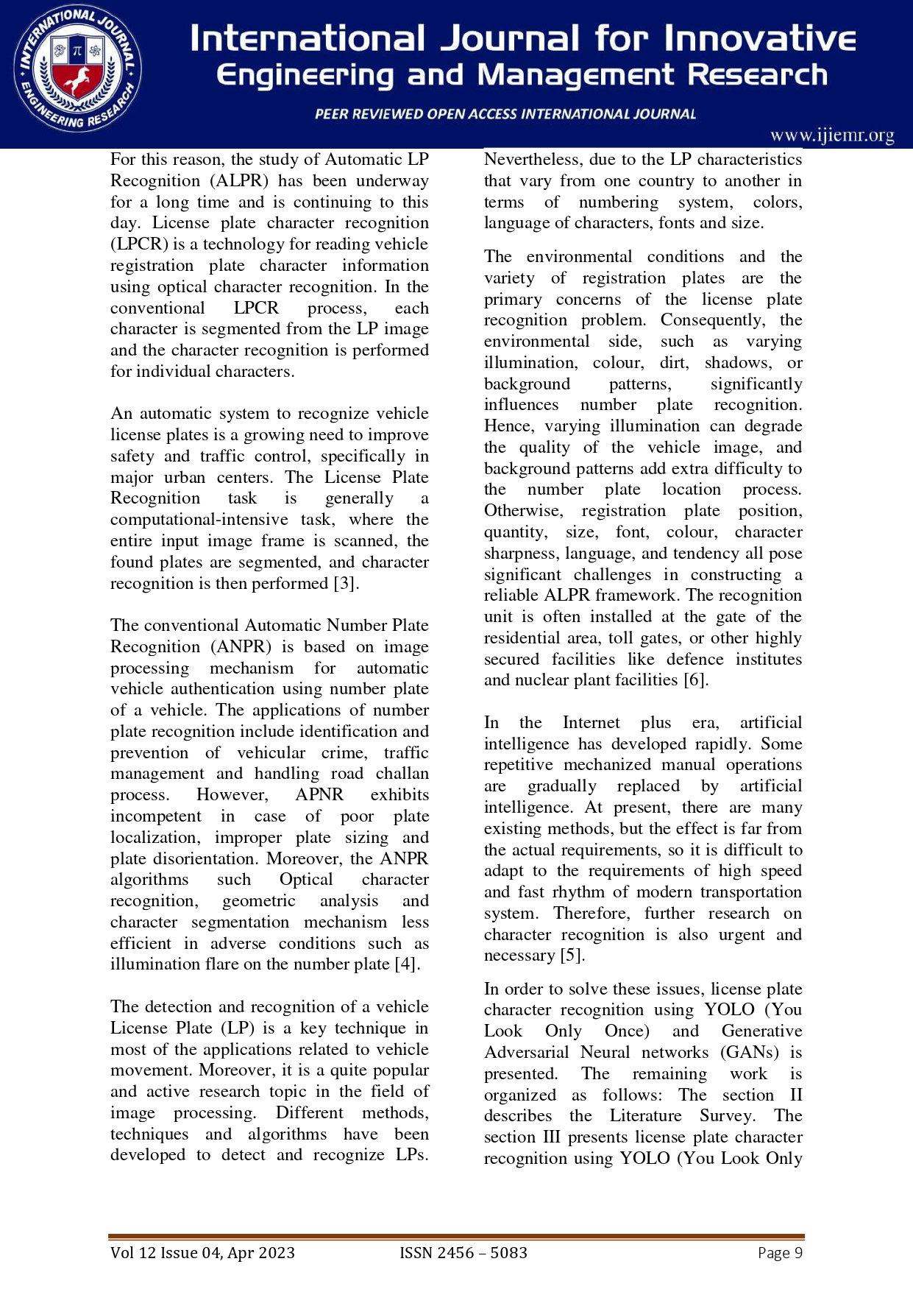
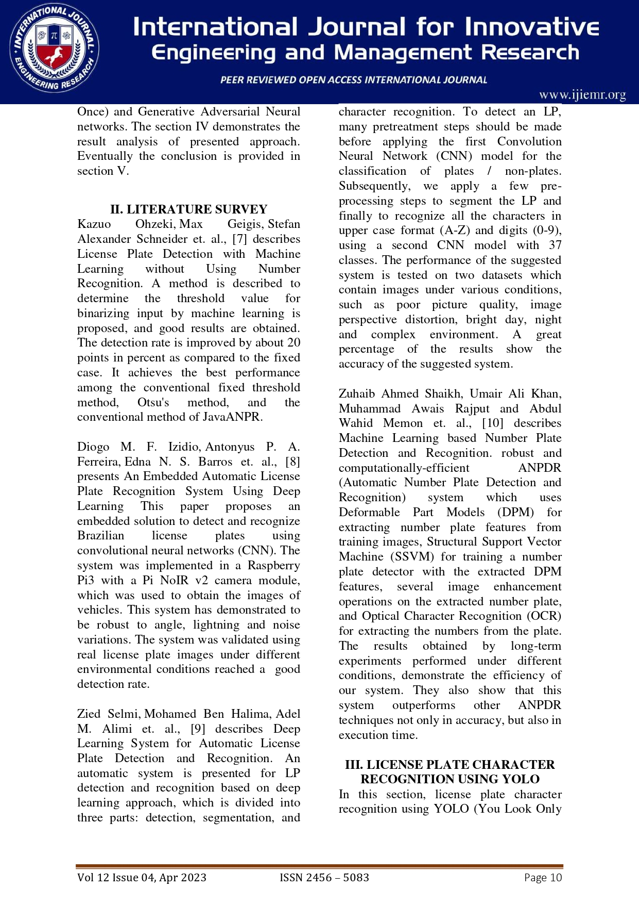

Slide 38
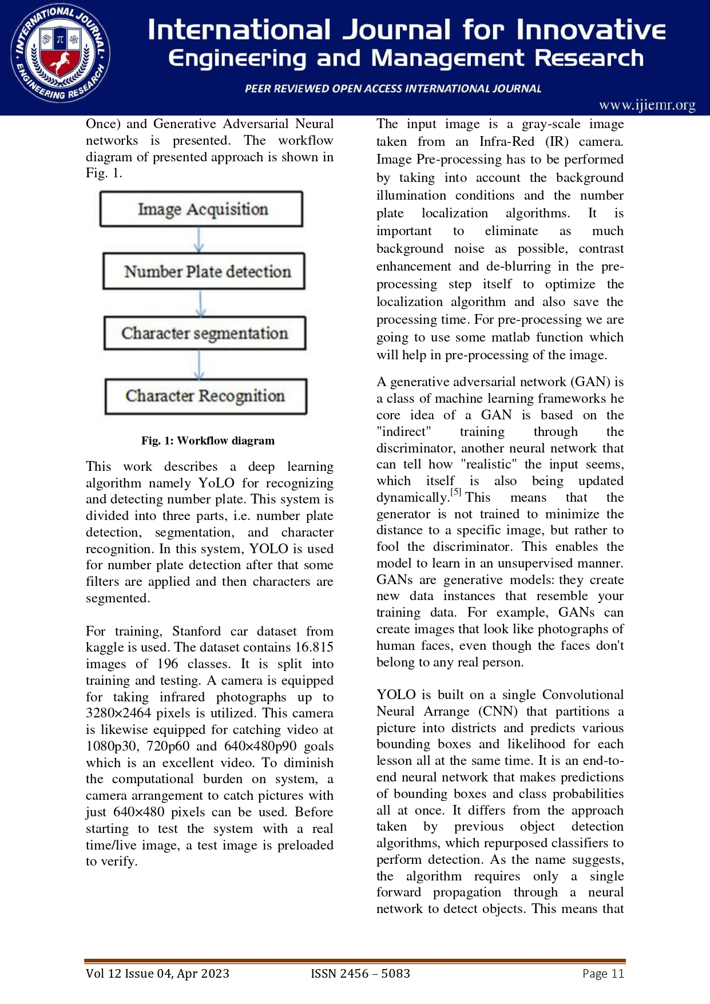
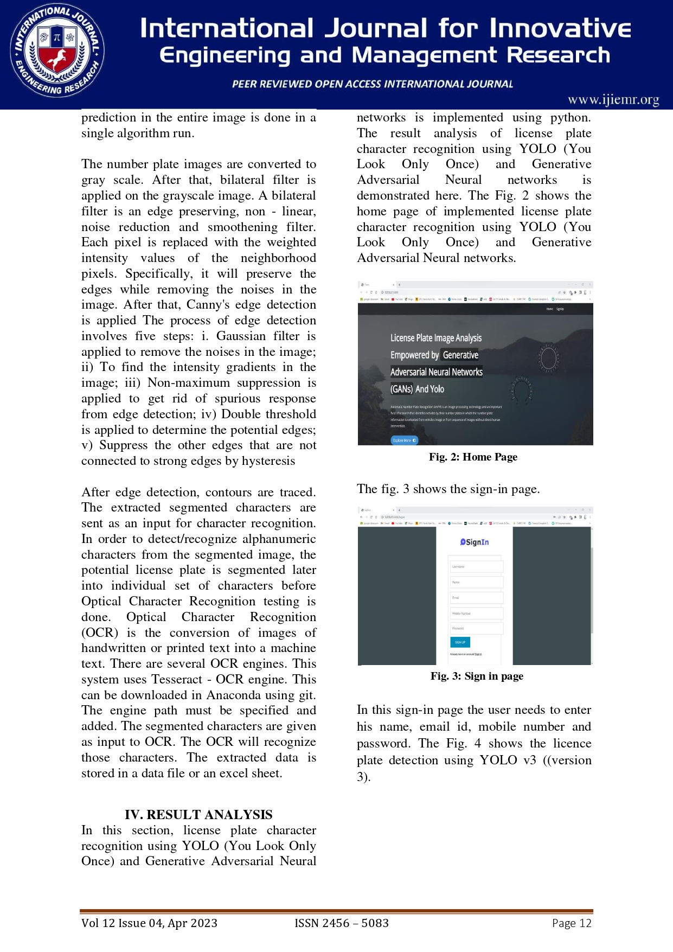

Slide 39
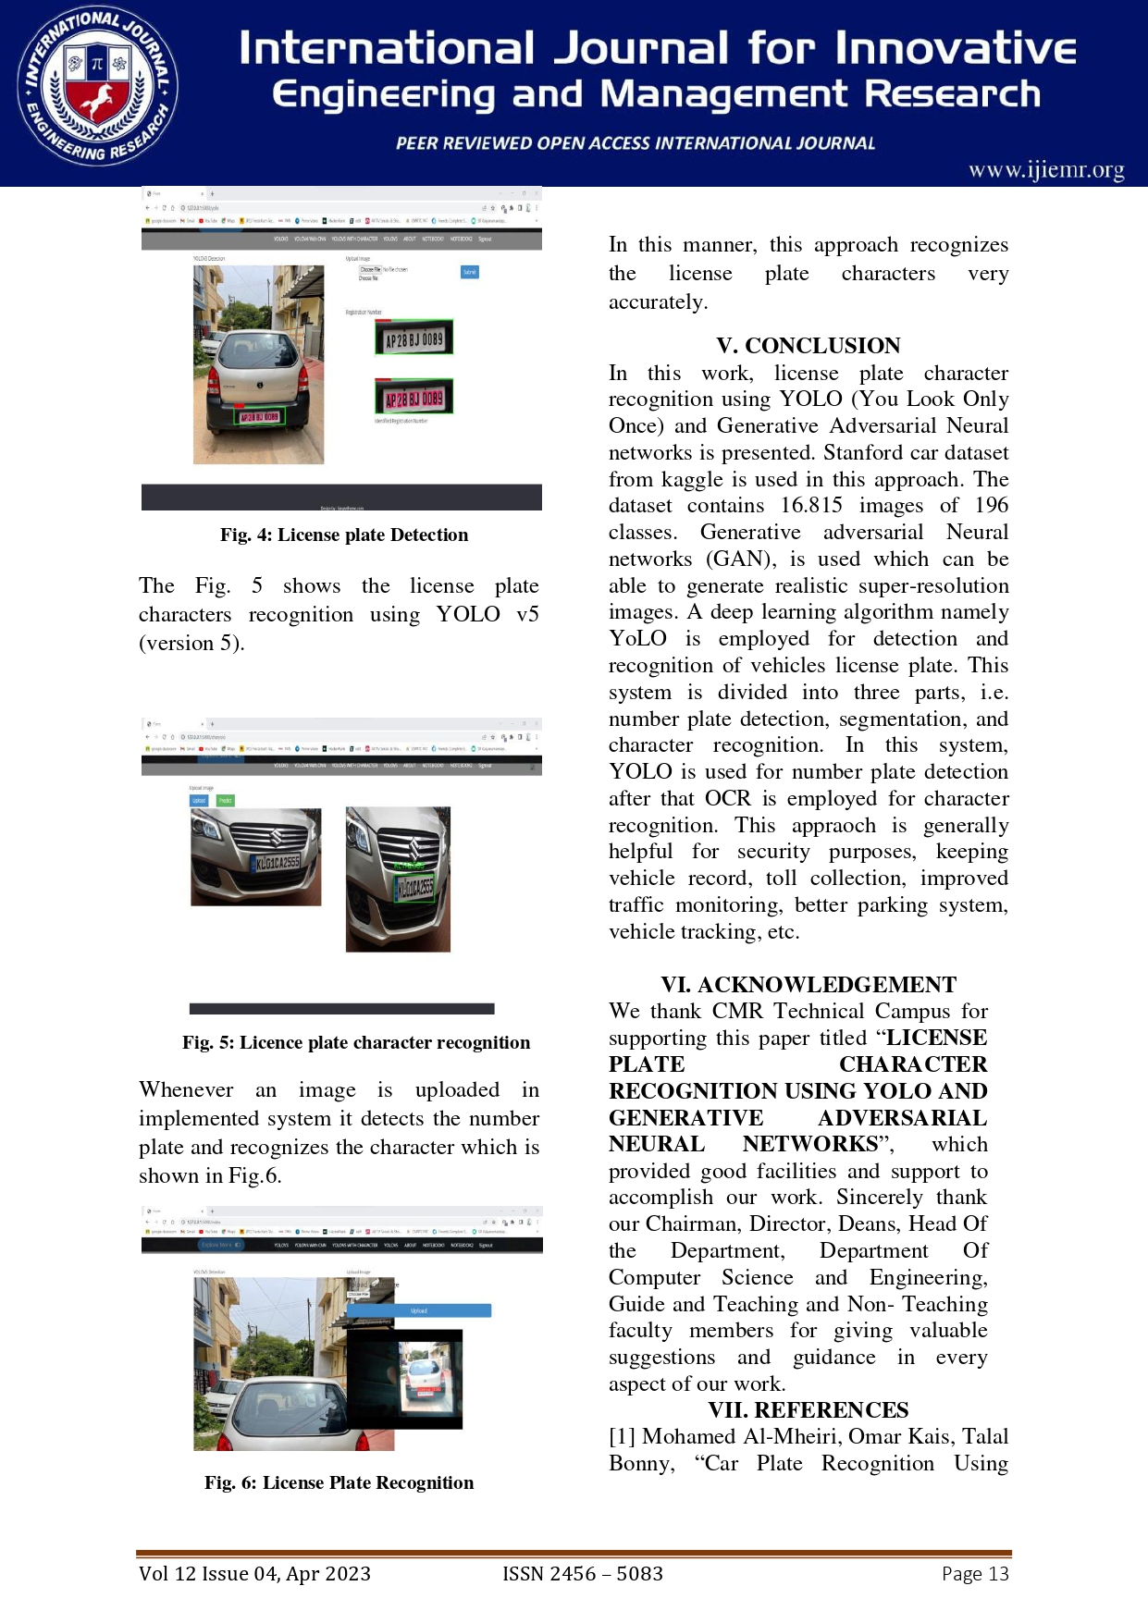
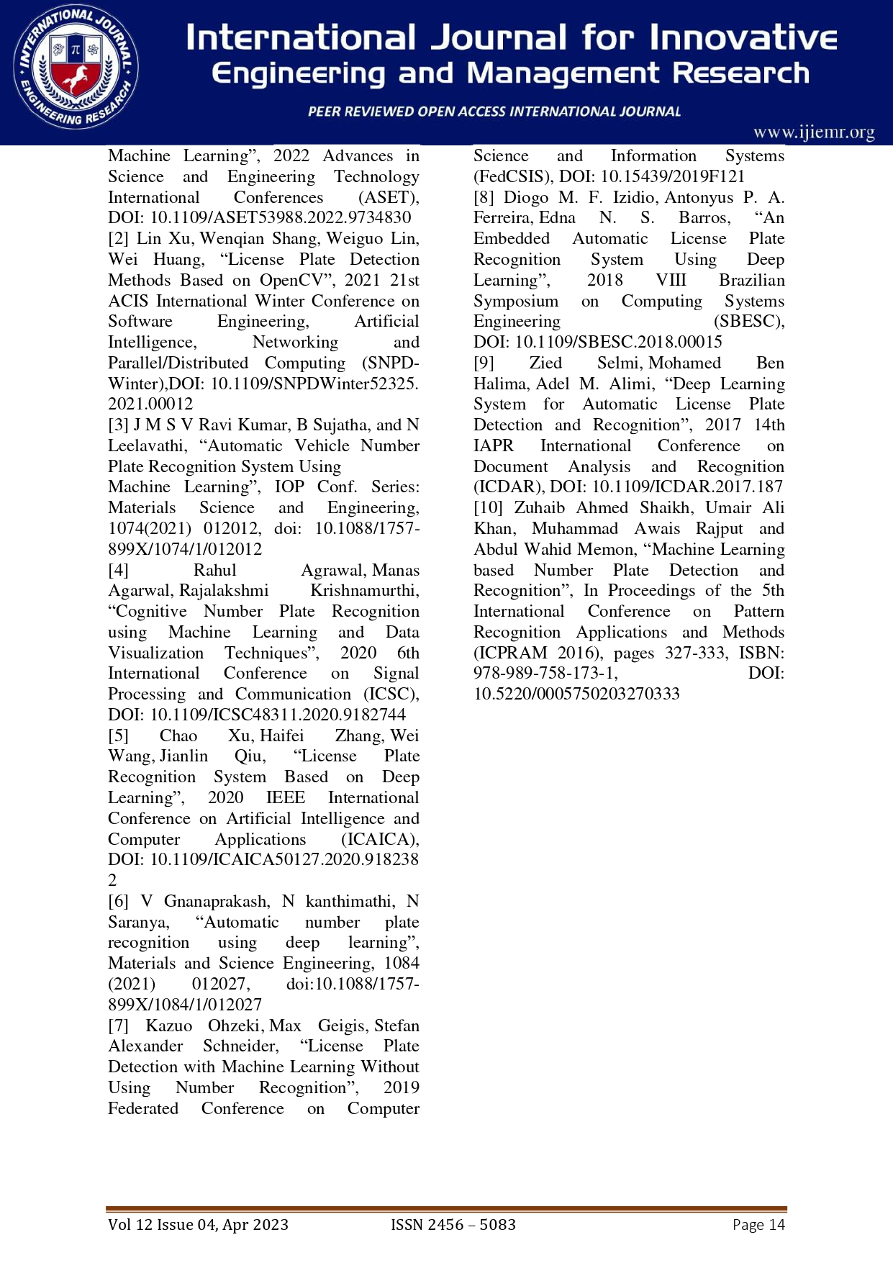

Slide 40
THANK YOU

